Slide 1


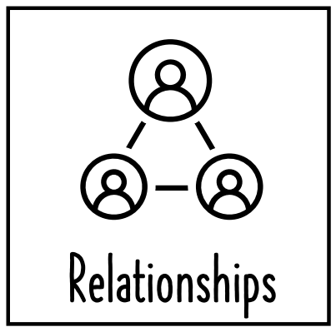










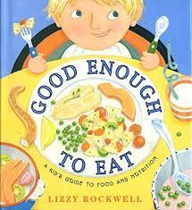


PSHE - British Values
LKS2
Summer 1
Year a
Good Enough to Eat: A Kid's Guide to Food and Nutrition Paperback – Illustrated, 1 Dec. 2000
by Lizzy Rockwell
MAIN CONCEPT
Weaving Concepts
Health and Wellbeing
It’s My Body
Key Vocabulary
Drugs – some drugs are healing medications, some are dangerous and illegal and some have restrictions.
Consent – seeking and giving permission in different situations.
Healthy – being healthy includes making choices about lifestyle, diet and hygiene.
British Values
The Rule of Law
Democracy
Individual Liberty
Mutual Respect and Tolerance
I will be learning about:
The different types of physical contact and consent.
How to live a healthy, balanced lifestyle.
Oral hygiene, germs and staying healthy, free from disease.
The difference between healing and harmful drugs.
How to make informed decisions about health.
Class Texts:
‘Good Enough
to Eat: A Kid’s
Guide to Food
and Nutrition’
By Lizzie
Rockwell
‘Demon Dentist’
By David
Walliams

