Slide 1
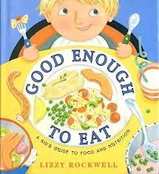
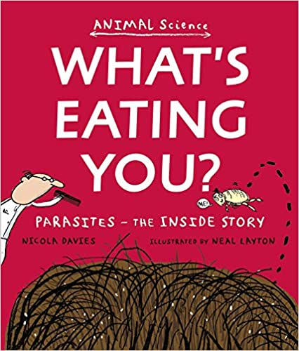
PSHE - British Values
UKS2
Summer 1
Year a
Good Enough to Eat: A Kid's Guide to Food and Nutrition Paperback – Illustrated, 1 Dec. 2000
by Lizzy Rockwell
MAIN CONCEPT
Weaving Concepts
Health and Wellbeing
It’s My Body
Key Vocabulary
Vaccination – a treatment to try and produce immunity against disease.
Illegal – against the law.
Lifestyle – the way you live, including eating, exercise, activity, hygiene and decisions.
British Values
The Rule of Law
Democracy
Individual Liberty
Mutual Respect and Tolerance
I will be learning about:
Friendships, consent and secrets including FGM.
Having a balanced, healthy lifestyle with positive habits.
How to take care of our bodies, including hygiene, vaccinations and oral hygiene.
Harmful substances including legal and illegal drugs.
Making healthy choices.
Class Text:
‘What’s
Eating You?’
By Nicola
Davies
‘The Bubble
Boy’
By Stewart
Foster

